Slide 1
Renoworks.com
RENOWORKS SOFTWARE, INC. (TSXV: RW | OTC: ROWKF)
Delivering a Design Platform and Project-Ready Homeowner Leads to The Remodeling Industry
Investor Presentation – May 2024
Notes:
Time, 0:30
Welcome everyone
Today talk about renoworks – software player in the $440 bln home repair and remodel space helping deliver project ready homeowner leads to building products material vendors in the industry so they can save money, sell more product and win more business.
This company has been in the business for 20 years but over the last 7 years have invested efforts on innovating on their platform and partnering with key technology innovators to achieve great growth. Today we’ll talk about how they have been able to succeed this way, where they are going and how they will continue to grow.

Slide 2
Forward-Looking Information
This presentation and the material contained herein are confidential and are not to be disclosed to the public. This presentation is for information purposes only and may not be reproduced or distributed to any other person or published, in whole or part, for any purpose whatsoever. This presentation does not constitute a general advertisement or general solicitation or an offer to sell or a solicitation to buy any securities in any jurisdiction. Such an offer can only be made by prospectus or other authorized offering document. This presentation and materials or fact of their distribution or communication shall not form the basis of, or be relied on in connection with any contract, commitment or investment decision whatsoever in relation thereto. No securities commission or similar authority in Canada or any other jurisdiction has in any way passed upon the adequacy or accuracy of the information contained in this presentation.
Certain statements in this presentation, other than statements of historical fact, are forward-looking information that involves various risks and uncertainties. Such statements relating to, among other things, the prospects for the company to enhance operating results, are necessarily subject to risks and uncertainties, some of which are significant in scope and nature. These uncertainties may cause actual results to differ from information contained herein. There can be no assurance that such statements will prove to be accurate. Actual results and future events could differ materially from those anticipated in such statements. These and all subsequent written and oral forward-looking statements are based on the estimates and opinions of the management on the dates they are made and expressly qualified in their entirety by this notice. Renoworks assumes no obligation to update forward-looking statements should circumstances or management's estimates or opinions change. The TSX Venture Exchange does not accept responsibility for the adequacy or accuracy of this document.
NOT FOR DISTRIBUTION; NO OFFERING
Notes:
Time, 0:05

Slide 3
Growing Quarterly Recurring Revenue
GROWTH IN ARR

Slide 4
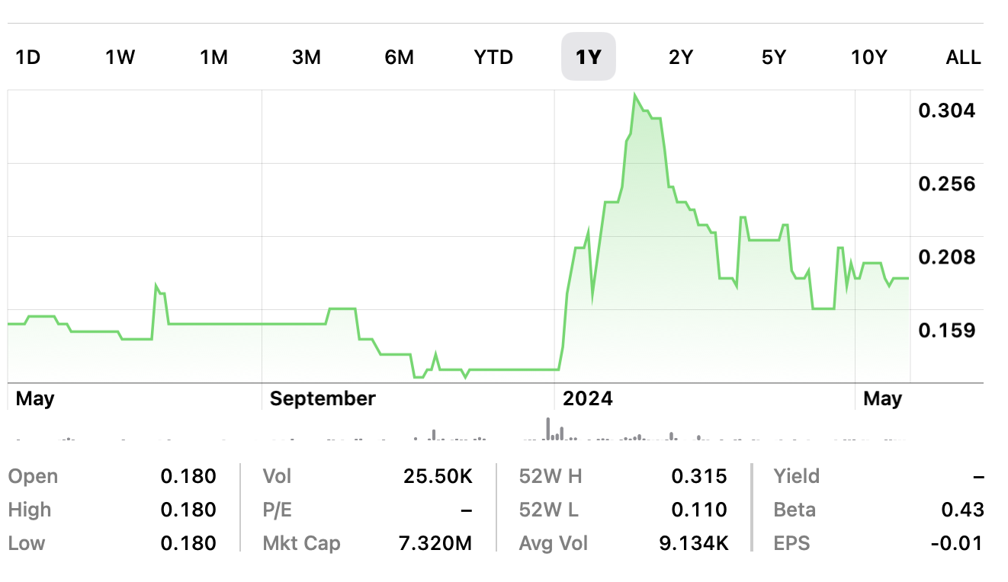
Tight Capital Structure & High Insider Ownership
FINANCIALS OVERVIEW
SYMBOL: | TSX.V: RW; Pink: ROWKF
Shares Outstanding (Basic): | 40,664,635
Options (Average Price - $0.34): | 3,543,000
Warrants: | 805,000 @ $0.60 (Oct. 20, 2025)
Shares Outstanding (Fully Diluted): | 45,012,635
Insiders: | 43%+
Market Cap (April 1, 2024): | $7.32M
Year High/Low: | $0.315/$0.11
Cash Balance (December 31, 2023): | $814,964
Margins (Avg.): | +75%
Year End: | December 31
TSX.V:RW
Notes:
As you can see we are still a small company, with a market cap of about $20M.
We have insider ownership in the 40% range and we have been quietly building the company over the last several years and believe we are now at an inflection point where we are seeing growth accelerate and we are butting up against some much larger players in the market – who need our technology and the partners on the platform are now at a critical mass that we believe we will see continued growth – and there are several ways this growth could accelerate significantly in the next 12-18 months.
We have cash of $1.5M, which you may think is low, however this is the most cash we have ever had and we operate the company in a lean manner and as you will see from our financials we are seeing revenue growth and burn rates coming down (double check these numbers. )

Slide 5
Reasons to Invest
THE OPPORTUNITY
Over 350 of the leading enterprise Manufacturers use Renoworks to represent their product catalogue in the design process – the RW MOAT
Growing high margin Recurring Revenue quarter over quarter
Multiple partner opportunities utilizing the Renoworks PRO Solution
Unique AI solution to bring a digital online marketplace to a large industry that lags behind
Over 5 million homeowners use our solutions annually
New product solutions that are leveraging unprecedented unique big data set of homeowner interactions with Manufacturer Products
Notes:
This is a summary slide
We have built a unique business having partnered with over 275 building product manufacturers where we have digitized their product libraries. These relationships and access to data represent Renoworks our single largest asset that we are just beginning to monetize. You may want to call it the RW Moat that we and others value.
Our solution brings a digital market place to an industry that lags behind.
We are uniquely positioned in that

Slide 6
Over 80% of homeowners are not able to visualize the outcome of their remodel project before it starts. Homeowner leads are of low quality and expensive for the Contractor.
INDUSTRY PROBLEMS:
Notes:
Doug to talk about the amount of data you have been collecting over the years and that you have been investing in unlocking the value around that data

Slide 7
We enable material manufacturers & their contractors to provide instant design solutions to homeowners before a project starts. We capture & qualify homeowner leads using visualization, data science, artificial intelligence, and machine learning so they can sell more product & win more business.
SOLUTION: THE RENOWORKS PLATFORM
Notes:
Doug to talk about the amount of data you have been collecting over the years and that you have been investing in unlocking the value around that data

Slide 8
Over US$450 Billion industry
Home Remodeling Market Still Strong and up over historical Averages
Notes:
SOPHIC Notes: Good to note here that despite Covid, the remodeling industry didn’t suffer, in fact, accelerated digital adoption further to adapt to the global situation. They see technology and data more so as vital component to their future and Renoworks is best positioned for that. And here’s why…
[Leo’s script] These challenges all take place at a time when the remodel market has seen its greatest growth. Covid didn’t decrease that growth but instead increased it. Homeowners are spending more and thus, manufacturers are investing more to ensure they are top of mind.

Slide 9
A Solid Base Business to Grow ARR
RESULTS: UNPRECEDENTED MARKET REACH
7,200,000 HOMEOWNERS EXTERIOR REMODEL PROJECTS
Contractors
EXTERIOR CONTRACTOR ORGANIZATIONS
200,000+
Contractors want to be connected to serious lead opportunities
Homeowners
With Renoworks positioned at the top of the lead funnel, we have unprecedented visibility into the entire remodel industry.
350 Renoworks Enterprise Customers
Notes:
Slide 4-5: Talk about how many manufacturers we have currently, # of homeowners that gives us access to, how we currently monetize, and give examples of customers we've been talking to who have recently upgrade to Renoworks 3.0 and the results they're seeing (use Plygem example here)

Slide 10
INCREASED ARR WITH NEW SOLUTIONS TO EXISTING ENTERPRISE CUSTOMERS
$3,000,000 - $4,000,000 ARR/year
Target: 2026
AI Lead Generation
Data Science Dashboard
Predictive Lead Score
ARR
~$2,000,000/year
350 Renoworks Enterprise Customers
Visualization
Engagement
Design
EXISTING SOLUTION
NEW SOLUTIONS
Notes:
Slide 4-5: Talk about how many manufacturers we have currently, # of homeowners that gives us access to, how we currently monetize, and give examples of customers we've been talking to who have recently upgrade to Renoworks 3.0 and the results they're seeing (use Plygem example here)

Slide 11
$7,200,000 - $9,000,000 ARR/year
Target: 2027
INCREASED ARR WITH NEW SOLUTIONS TO CONTRACTORS
Contractor SAAS Lead Generation Platform
Selling Tool
Receive Leads from Manufacturers
Unlock Lead Insight
Embed RW Technology on Partner Platforms
$3,000,000 - $4,000,000 ARR/year
Target: 2026
GATED AI Design
Data Science Dashboard
Predictive Lead Score
ARR
~$2,000,000/year
350 Renoworks Enterprise Customers
Visualization
Engagement
Design
EXISTING SOLUTION
NEW SOLUTIONS
Notes:
Slide 4-5: Talk about how many manufacturers we have currently, # of homeowners that gives us access to, how we currently monetize, and give examples of customers we've been talking to who have recently upgrade to Renoworks 3.0 and the results they're seeing (use Plygem example here)

Slide 12
Partner Channels to Access Contractors
A KEY GROWTH AREA
LEAD AGGREGATORS
There are many technology companies also serving the contractor space that want access to Renoworks Technology.
The technology companies provide other pieces of core value chain functionality – measurements, estimating and proposals.
Big Box Retailers and Lead Aggregators are interested in RW end to end solution – providing project ready leads for contractors.
BUILDING PRODUCT MANUFACTURERS
Access to 200,000+ Contractors
BUILDING PRODUCTS DISTRIBUTORS -
Access to 200,000+ Contractors
BIG BOX RETAILERS -
100,000+ Contractors
TECHNOLOGY PARTNERS -
100,000+ Contractors
Notes:
Slide 4-5: Talk about how many manufacturers we have currently, # of homeowners that gives us access to, how we currently monetize, and give examples of customers we've been talking to who have recently upgrade to Renoworks 3.0 and the results they're seeing (use Plygem example here)

Slide 13
Current Partners as of April 30
TECHNOLOGY AND INDUSTRY PARTNERS
Lead Aggregation
Marketing Agencies
Lead Generation
CRMs
Sales Coaching
Sales Enablement
Measurements
Quoting

Slide 14
FY 2023 and Q1 2024
FINANCIALS OVERVIEW
Accelerating revenue growth profile
strong and growing recurring revenue
broad-based growth across all business segments
Strong underlying margin profile built to scale
Solid balance sheet with net cash position
Invested to grow platform for integration with partners, and sales and marketing
Focus on increasing recurring revenue will lead to future profitability (FY 2024)
Q1 2024 results:
Revenue $1,479,390 up 9% over Q1 2023.
Margin 75% vs 73%.
Deferred Revenue $2,057,303
 | FY 2022 | FY 2023 | Y/Y
Revenue | $5,941,830 | $6,292,601 | +6%
Gross Margin | 64% | 70% | +600bps
Deferred Revenue | $1,413,786 | $1,633,394 | +16%
Working Capital* | $1,459,074 | $1,264,069 | -13%
*Excluding deferred revenue, a significant non-cash item included in working capital, the Company’s working capital at March 31, 2024 is positive $1,523,220.
Notes:
Slide 10: Financial overview - the current state of the revenue - how much is recurring, the GM profile and cash balance pro forma the raise.

Slide 15
Strong Position to Accelerate Growth
OUR PATH TO ONGOING SUCCESS
Contractor Networks
FOCUS – leverage Renoworks channel reach to sell our Renoworks PRO Solution to Contractors.
Monetization of Data Offerings with Existing Enterprise Customers
FOCUS – increasing ARR
Leverage New and Existing Partnerships
FOCUS – integrate RW technology on other partner platforms and to bring complimentary solutions to the market.
New Sales Acquisitions
FOCUS – we continue to add more Enterprise Customers to our ecosystem.
Notes:
Slide 11: Catalysts and things to watch for
- customers cutting over to the new platform leading to higher revenue growth
- partnerships to unlock contractor leads - which could lead to significant revenue growth and recurring revenue visibility

Slide 16
Contact Us
FOR MORE INFORMATION
DOUG VICKERSON, CEO
E: doug.vickerson@renoworks.com
T: 403.296.3880
Renoworks Software Inc.
www.renoworks.com

